Slide 1
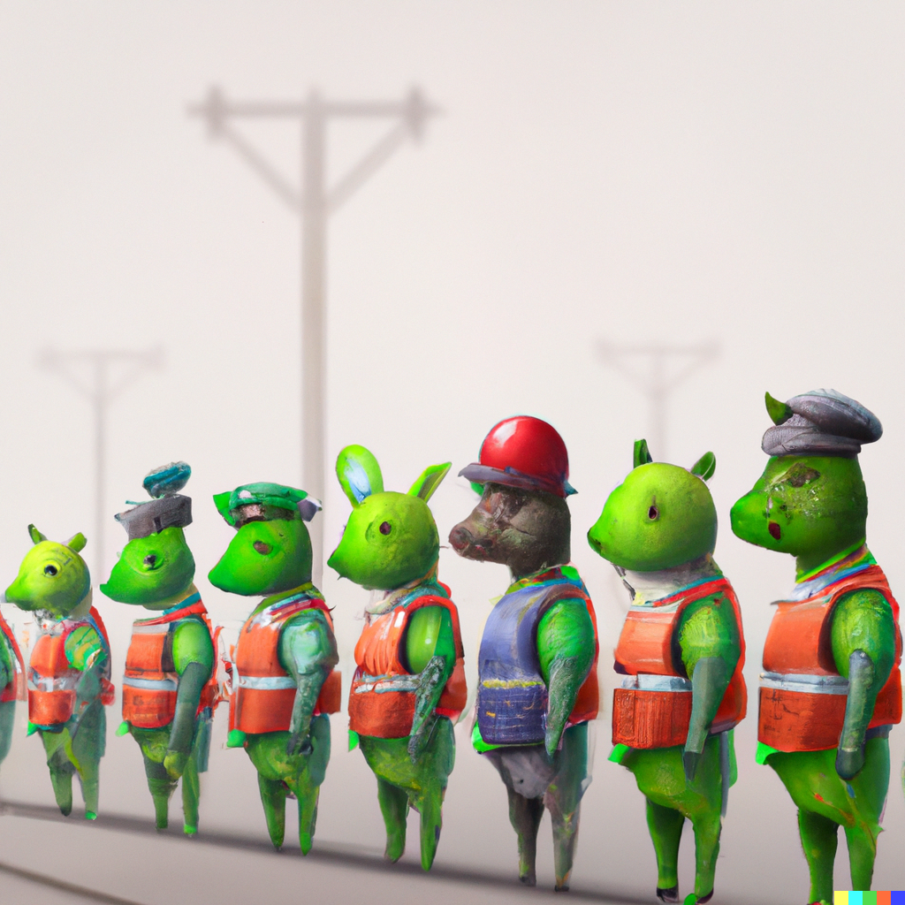
K-Nearest Neighbor and ML Basics
Applied Machine Learning Derek Hoiem
Dall-E

Slide 2
Today’s Lecture
Overview of machine learning process
K-Nearest Neighbor Algorithm
Measuring and understanding error
Example applications
HW 1 overview
Deep Face

Slide 3
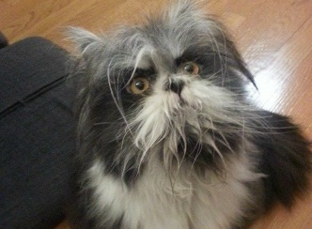
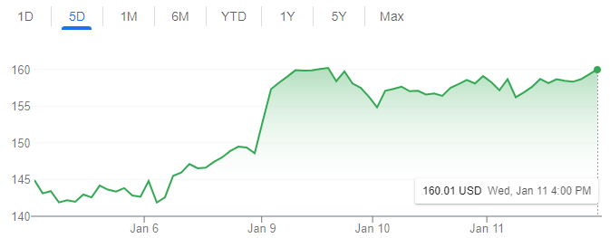
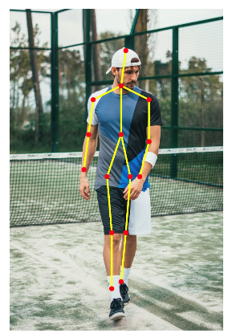
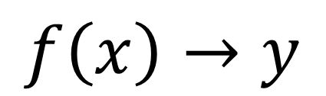
Machine learning model maps from features to prediction
$$f\left(x\right)→y$$
Features
Prediction
Examples
Classification
Is this a dog or a cat?
Is this email spam or not?
Regression
What will the stock price be tomorrow?
What will be the high temperature tomorrow?
Structured prediction
What is the pose of this person?

Slide 4
Learning has three stages
Training: optimize model parameters
Validation: intermediate evaluations to design/select model
Test: final performance evaluation

Slide 5

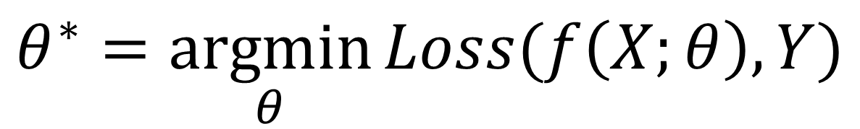

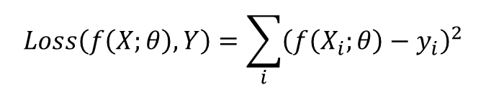

Training: the model is fit to data to minimize a loss or maximize an objective function
$$θ^{∗}=\underset{θ}{argmin}{Loss(f\left(X;θ\right),Y)}$$
Model parameters that minimize loss
Features of all training examples
“Ground Truth” predictions of all training examples
$$X$$
$$Y$$
Loss: sum squared error
Example
Learn to predict next day’s temperature given preceding days’ temperatures
$$Loss\left(f\left(X;θ\right),Y\right)=\sum_{i}{{\left(f\left(X_{i};θ\right)−y_{i}\right)}^{2}}$$
37.5 | 41.2 | 51.0 | 48.3
47.0 | 46.5 | 48.9 | 50.5
…
67.0 | 64.7 | 63.0 | 61.4
50.5
47.6
…
60.2
1 row per example
Model: linear
$$f(X_{i};θ)=AX_{i}+b$$
1 column per feature
Optimization via ordinary least squares regression

Slide 6
Model design and “hyper parameter” tuning is performed using a validation set
linear regression neural network
Select model
Set training parameters
Feature selection
Learning rate, regularization parameters, …
Sometimes, there are clear “train”, “val”, and “test” sets. Other times, you need to split “train” into a train set for learning parameters and a val set for checking model performance

Slide 7
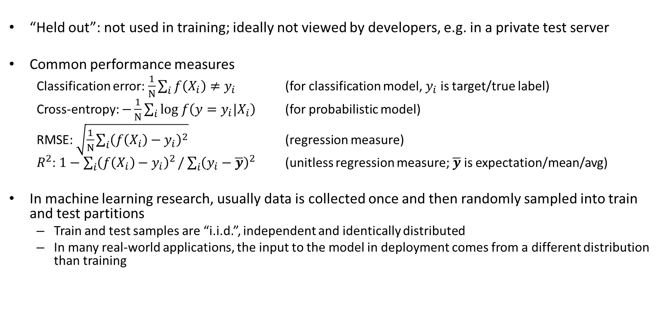
Testing: The effectiveness of the model is evaluated on a held out test set
“Held out”: not used in training; ideally not viewed by developers, e.g. in a private test server
Common performance measures
Classification error: $\frac{1}{N}\sum_{i}{f\left(X_{i}\right)≠y_{i}}$ (for classification model, $y_{i}$ is target/true label)
Cross-entropy: $−\frac{1}{N}\sum_{i}{log f\left({{y=y}_{i}|X}_{i}\right)}$ (for probabilistic model)
RMSE: $\sqrt{\frac{1}{N}\sum_{i}{{\left(f\left(X_{i}\right)−y_{i}\right)}^{2}}}$ (regression measure)
$R^{2}$: $1−\sum_{i}{{\left(f\left(X_{i}\right)−y_{i}\right)}^{2}}/$ $\sum_{i}{{\left(y_{i}−\overline{y}\right)}^{2}}$ (unitless regression measure; $\overline{y}$ is expectation/mean/avg)
In machine learning research, usually data is collected once and then randomly sampled into train and test partitions
Train and test samples are “i.i.d.”, independent and identically distributed
In many real-world applications, the input to the model in deployment comes from a different distribution than training

Slide 8
Recap of training and evaluation
Modify design based on initial results
Model/Training Design
Validate Model
Validation Data
Train
Model
Evaluate model design
Training Data
Test Model
Test Data
Final evaluation

Slide 9
What class do you think the ‘+’ belongs to?
x
x
x
o
x
x
x
+
o
x
o
x
o
o
o
o
x2
x1

Slide 10
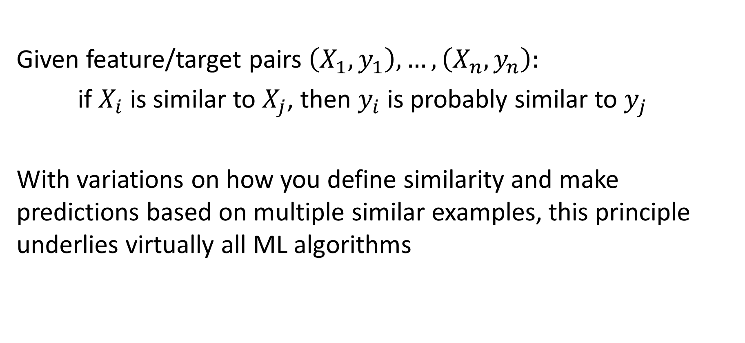
Key principle of machine learning
Given feature/target pairs $\left(X_{1},y_{1}\right),…,\left(X_{n},y_{n}\right):$
if $X_{i}$ is similar to $X_{j}$, then $y_{i}$ is probably similar to $y_{j}$
With variations on how you define similarity and make predictions based on multiple similar examples, this principle underlies virtually all ML algorithms

Slide 11
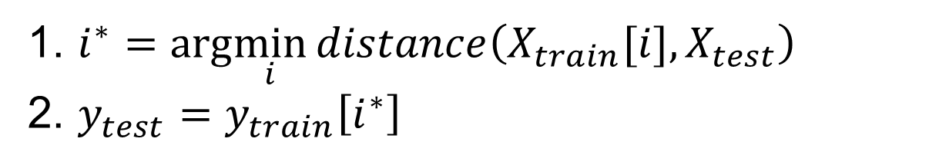
Nearest neighbor algorithm
For given test features, assign the label / target value of the most similar training features
1. $i^{∗}=arg\min_{i}{distance\left(X_{train}[i],X_{test}\right)}$
2. $y_{test}=y_{train}\left[i^{∗}\right]$
Distance function is up to designer. Simplest is L2 distance.

Slide 12
K-nearest neighbor: predict based on K closest training samples
x
x
x
o
x
x
x
+
o
o
x
x
o
o
+
o
o
x2
x1

Slide 13
1-nearest neighbor
x
x
x
o
x
x
x
+
o
o
x
x
o
o
+
o
o
x2
x1

Slide 14
3-nearest neighbor
x
x
x
o
x
x
x
+
o
o
x
x
o
o
+
o
o
x2
x1

Slide 15
5-nearest neighbor
x
x
x
o
x
x
x
+
o
o
x
x
o
o
+
o
o
x2
x1

Slide 16
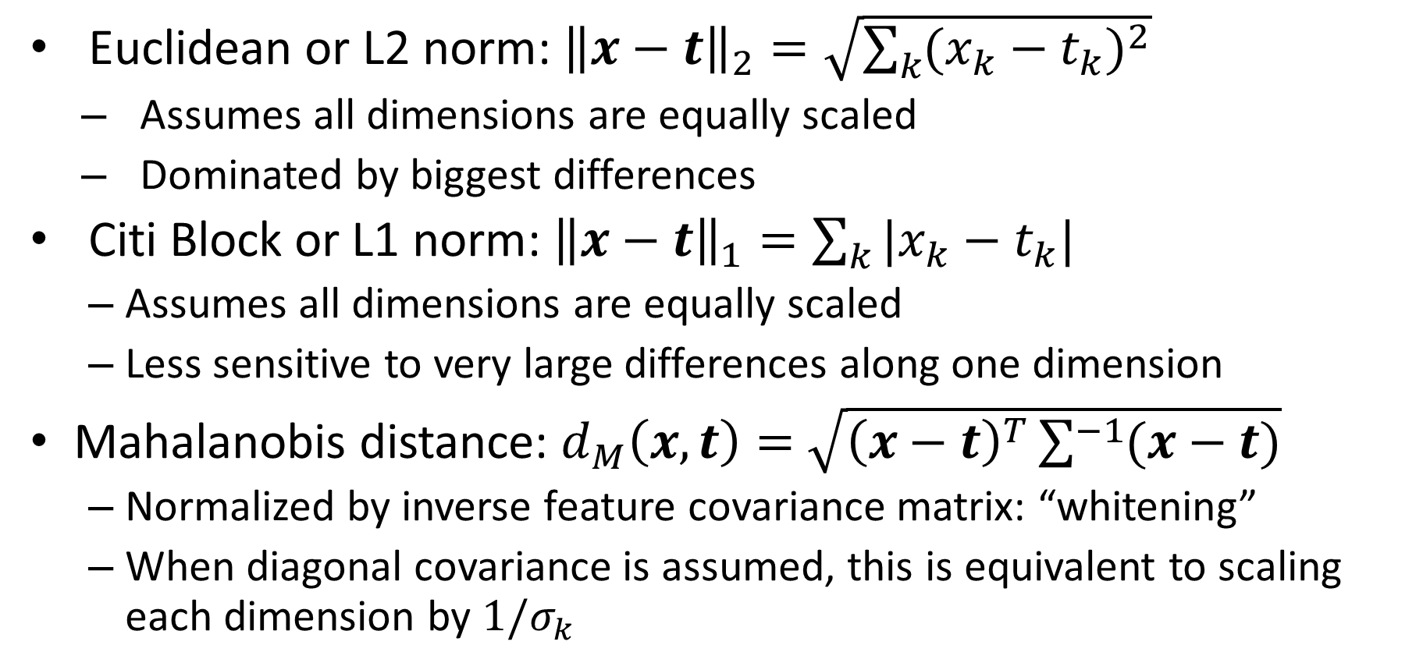
KNN Distance Function
Euclidean or L2 norm: ${\left\|x−t\right\|}_{2}=\sqrt{\sum_{k}{{(x_{k}−t_{k})}^{2}}}$
Assumes all dimensions are equally scaled
Dominated by biggest differences
Citi Block or L1 norm: ${\left\|x−t\right\|}_{1}=\sum_{k}{|x_{k}−t_{k}|}$
Assumes all dimensions are equally scaled
Less sensitive to very large differences along one dimension
Mahalanobis distance: $d_{M}\left(x, t\right)=$ $\sqrt{{\left(x−t\right)}^{T}\sum^{−1}{(x−t)}}$
Normalized by inverse feature covariance matrix: “whitening”
When diagonal covariance is assumed, this is equivalent to scaling each dimension by $1/σ_{k}$
$x$ and $t$ are training and test sample feature vectors

Slide 17
KNN Classification vs Regression
For classification, prediction is usually the mode or most common class of the returned labels
For regression, prediction is usually the arithmetic mean (average, informally) of the returned values

Slide 18
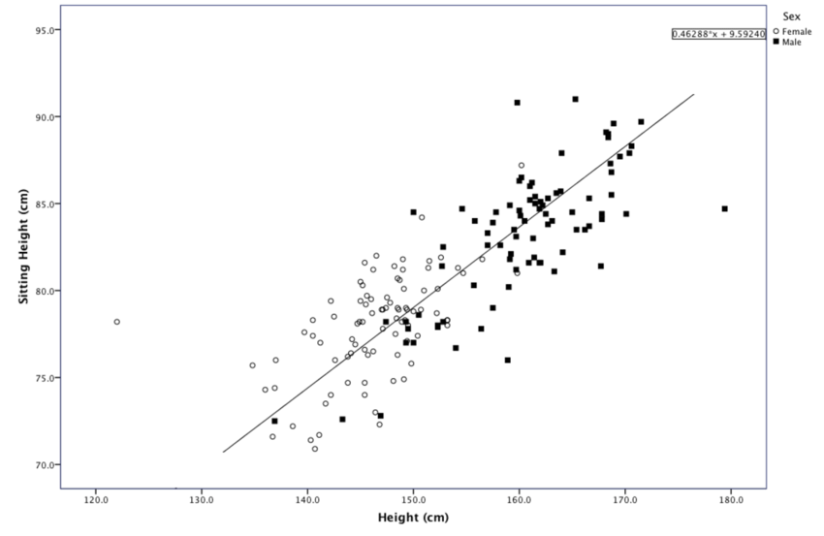
o
+
x
Predict sex from standing/sitting heights
https://www.researchgate.net/figure/Scatter-plot-of-Sitting-Height-over-Height-for-males-and-females_fig3_301724988

Slide 19
x
+
Predict sitting height from standing height
https://www.researchgate.net/figure/Scatter-plot-of-Sitting-Height-over-Height-for-males-and-females_fig3_301724988

Slide 20
KNN Classification Demos
https://lecture-demo.ira.uka.de/knn-demo/#
http://vision.stanford.edu/teaching/cs231n-demos/knn/

Slide 21
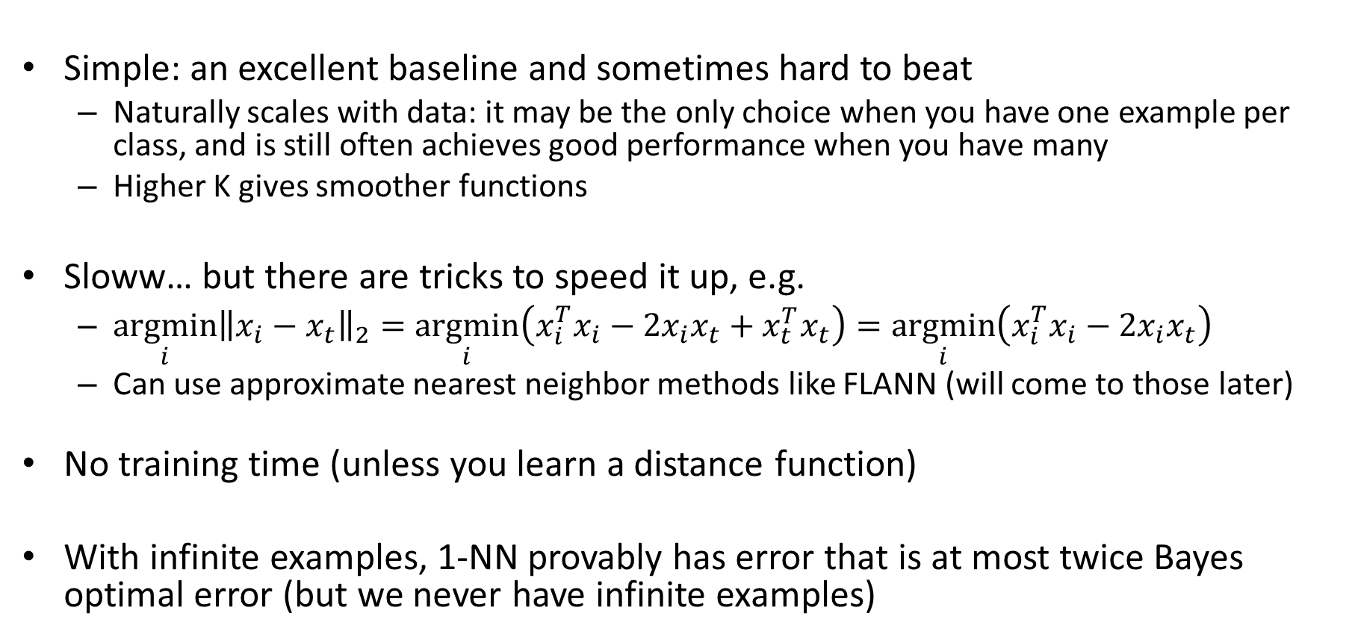
Comments on K-NN
Simple: an excellent baseline and sometimes hard to beat
Naturally scales with data: it may be the only choice when you have one example per class, and is still often achieves good performance when you have many
Higher K gives smoother functions
Sloww… but there are tricks to speed it up, e.g.
$\underset{i}{argmin}{{\left\|x_{i}−x_{t}\right\|}_{2}}=\underset{i}{argmin}\left(x_{i}^{T}x_{i}−{2x}_{i}x_{t}+x_{t}^{T}x_{t}\right)=\underset{i}{argmin}\left(x_{i}^{T}x_{i}−{2x}_{i}x_{t}\right)$
Can use approximate nearest neighbor methods like FLANN (will come to those later)
No training time (unless you learn a distance function)
With infinite examples, 1-NN provably has error that is at most twice Bayes optimal error (but we never have infinite examples)
can be precomputed

Slide 22
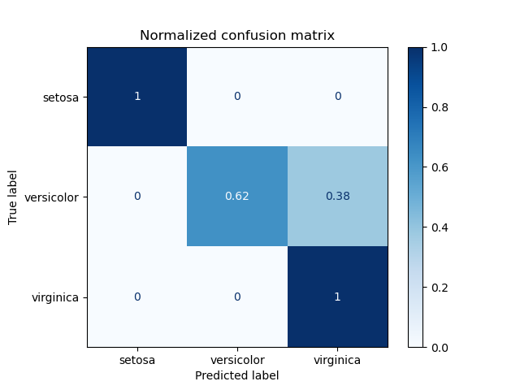
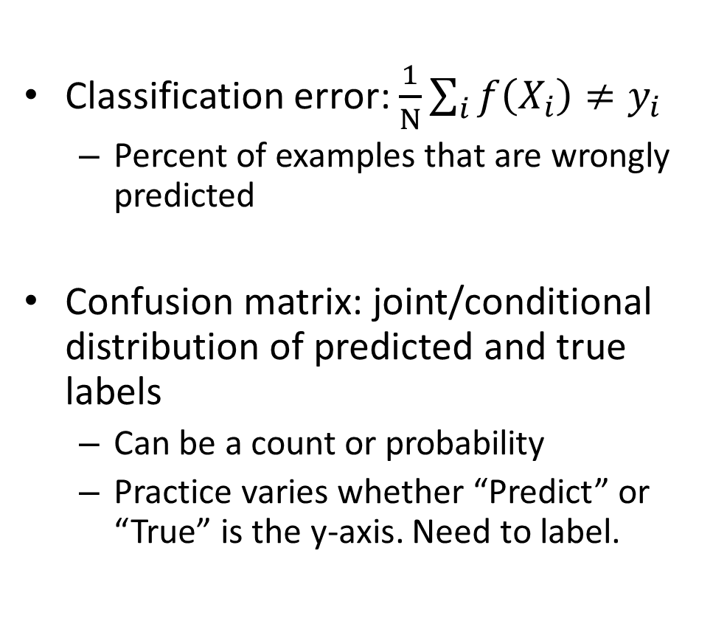
How do we measure and analyze classification error?
Classification error: $\frac{1}{N}\sum_{i}{f\left(X_{i}\right)≠y_{i}}$
Percent of examples that are wrongly predicted
Confusion matrix: joint/conditional distribution of predicted and true labels
Can be a count or probability
Practice varies whether “Predict” or “True” is the y-axis. Need to label.
https://scikit-learn.org/stable/auto_examples/model_selection/plot_confusion_matrix.html

Slide 23
Measuring error example
Confusion Matrix:
Count
True | Predicted
Y | Y
N | Y
Y | Y
Y | N
N | N
N | Y
N | N
 |  | Predicted | N
 |  | N | Y
True | N
 | Y
Classification Error:
P(predicted | true)
 |  | Predicted | N
 |  | N | Y
True | N
 | Y

Slide 24
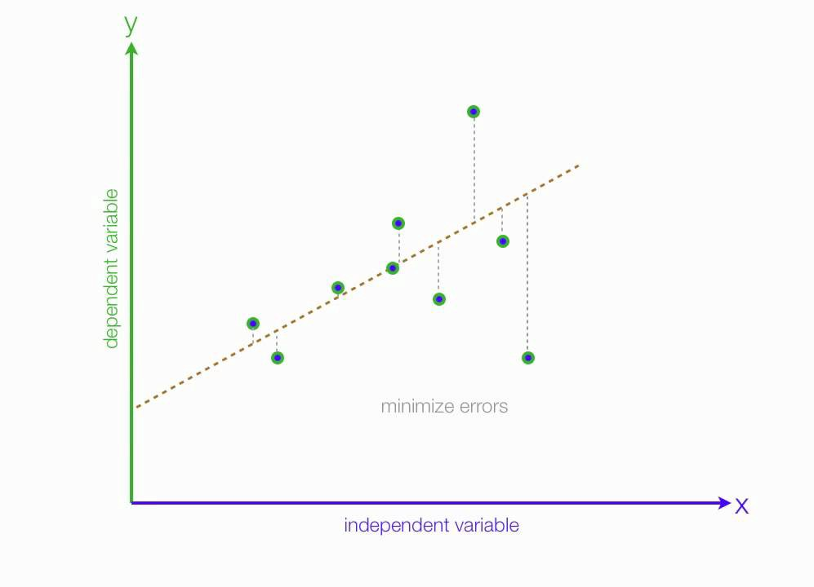
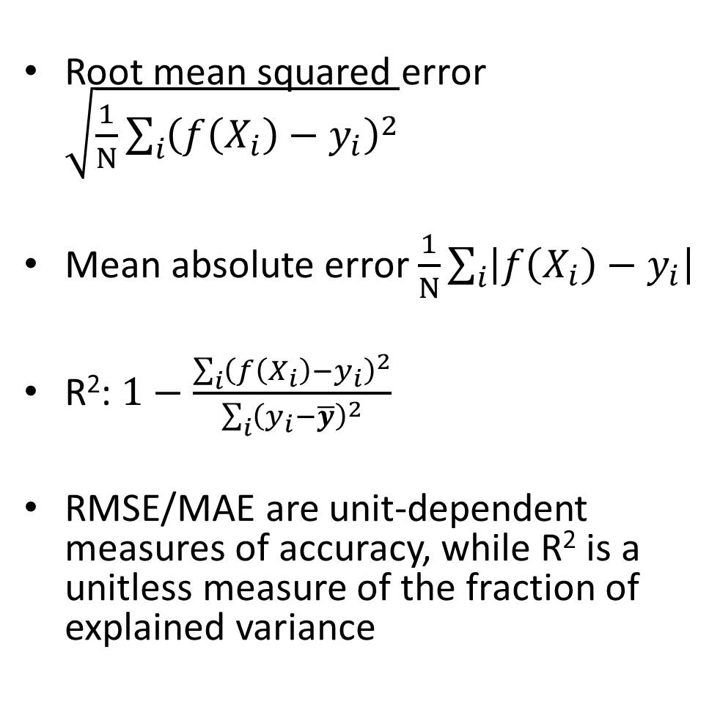
How do we measure and analyze regression error?
Root mean squared error $\sqrt{\frac{1}{N}\sum_{i}{{\left(f\left(X_{i}\right)−y_{i}\right)}^{2}}}$
Mean absolute error $\frac{1}{N}\sum_{i}{\left|f\left(X_{i}\right)−y_{i}\right|}$
R²: $1−\frac{\sum_{i}{{\left(f\left(X_{i}\right)−y_{i}\right)}^{2}}}{\sum_{i}{{\left(y_{i}−\overline{y}\right)}^{2}}}$
RMSE/MAE are unit-dependent measures of accuracy, while R² is a unitless measure of the fraction of explained variance
$$f\left(x\right)$$
(unexplained variance)
(total variance)
Fig: https://medium.com/analytics-vidhya/mae-mse-rmse-coefficient-of-determination-adjusted-r-squared-which-metric-is-better-cd0326a5697e

Slide 25
Sources of test error for a trained model
Intrinsic: sometimes it is not possible to achieve zero error given available features (e.g. handwriting, weather prediction)
Bayes optimal error: The error if the true function P(y|x) is known
Model Bias: the model is limited so that Bayes optimal error cannot be achieved for an infinite training set
Model Variance: given finite training data, different parameters and predictions would result from different samplings of data
Distribution Shift: some examples are more likely in test than training, i.e. true P(x) is different for train and test
E.g., datasets are collected at different times and frequency of content has changed
Function Shift: P(y|x) is changed between train and test
E.g., the predicted answer to “What is your favorite TV show?” changes over time
Others: imperfect optimization, final performance measure is different than training loss

Slide 26
Effect of Training Size
Fixed model
Error
Testing
Generalization Error
Training
Number of Training Examples

Slide 27
Sources of error and training size
Fixed model
Due to limited training data (model variance) and distribution shift
Testing
Error
Test error with infinite training examples
Due to difference in P(y|x) in training and test (function shift)
Train error with infinite training examples
Training
Number of Training Examples
Due to limited power of model (model bias) and unavoidable intrinsic error (Bayes optimal error)

Slide 28
Something to think about…
Why is it important to have a validation set? Why not simply evaluate all your trained models on the test set and then choose the best?

Slide 29
HW 1 Preview

Slide 30
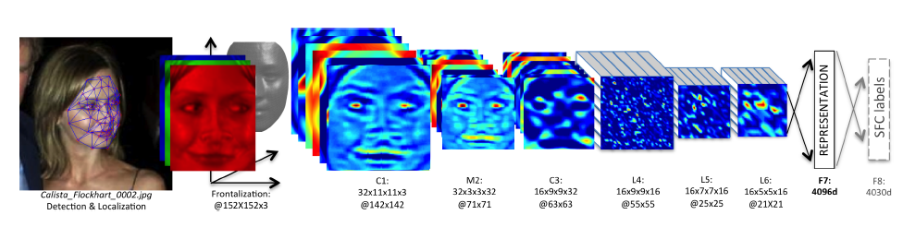
KNN Usage Example: Deep Face
CVPR 2014
Detect facial features
Align faces to be frontal
Extract features using deep network while training classifier to label image into person (dataset based on employee faces)
In testing, extract features from deep network and use nearest neighbor classifier to assign identity
Performs similarly to humans in the LFW dataset (labeled faces in the wild)
Can be used to organize photo albums, identifying celebrities, or alert user when someone posts an image of them
If this is used in a commercial deployment, what might be some unintended consequences?
This algorithm is used by Facebook (though with expanded training data)

Slide 31
KNN Summary
Key Assumptions
Samples with similar input features will have similar output predictions
Depending on distance measure, may assume all dimensions are equally important
Model Parameters
Features and predictions of the training set
Designs
K (number of nearest neighbors to use for prediction)
How to combine multiple predictions if K > 1
Feature design (selection, transformations)
Distance function (e.g. L2, L1, Mahalanobis)
When to Use
Few examples per class, many classes
Features are all roughly equally important
Training data available for prediction changes frequently
Can be applied to classification or regression, with discrete or continuous features
Most powerful when combined with feature learning
When Not to Use
Many examples are available per class (feature learning with linear classifier may be better)
Limited storage (cannot store many training examples)
Limited computation (linear model may be faster to evaluate)

Slide 32
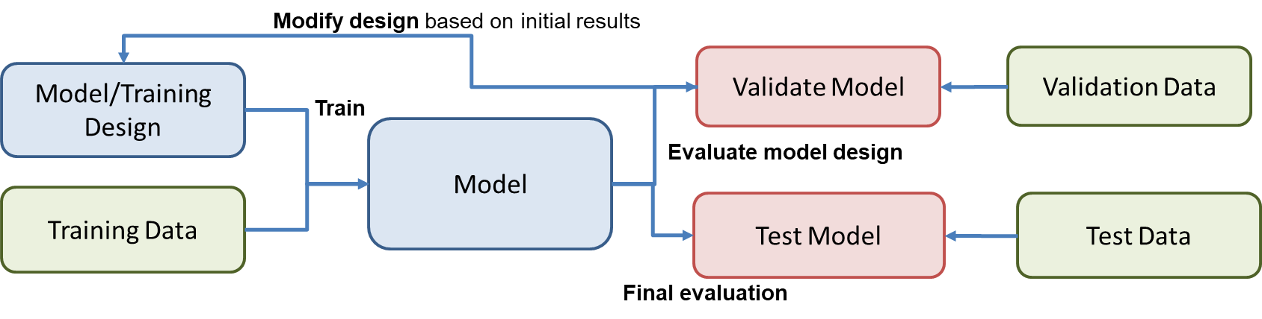
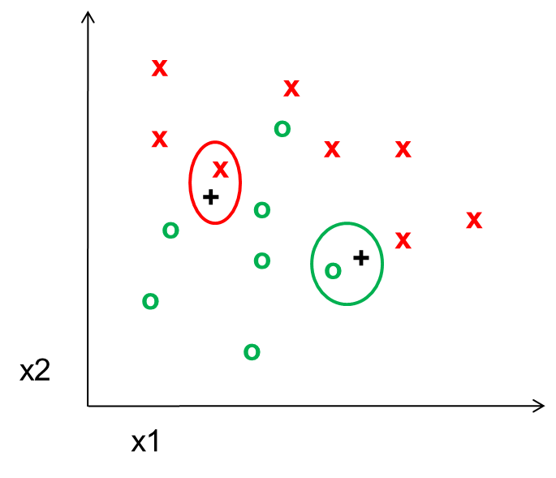
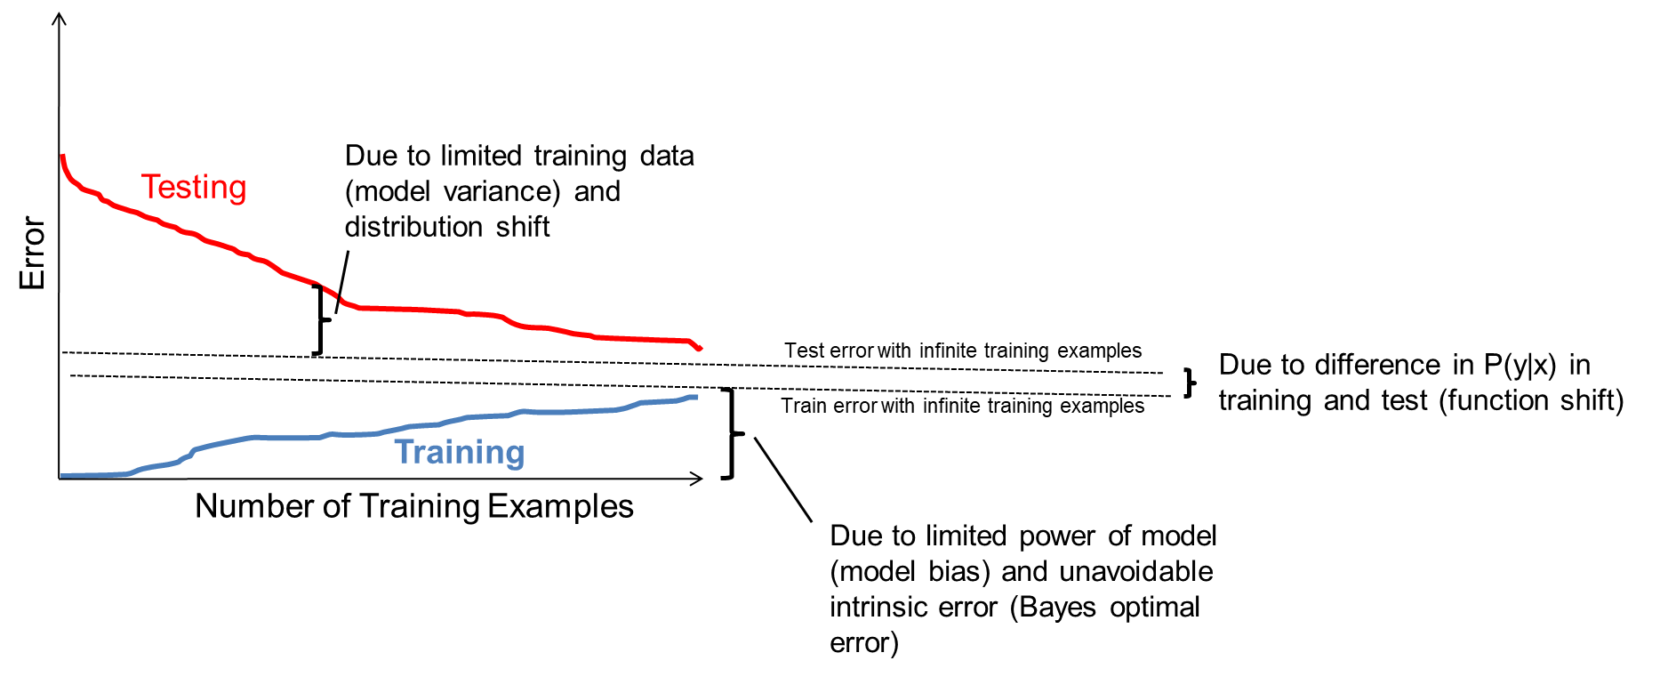
Things to remember
Supervised machine learning involves:
Fitting parameters to a model using training data
Refining the model based on validation performance
Evaluating the final model on a held out test set
KNN is a simple but effective classifier/regressor that predicts the label of the most similar training example(s)
With more samples, fitting the training data becomes harder, but test error is expected to decrease
Test errors have many sources
intrinsic to problem
model bias / limited power
model variance / limited training data
differences in training and test distributions
Model design and fitting is just one part of a larger process in collecting data, developing, and deploying models

Slide 33
Next week
Probabilistic models and Naïve Bayes
Linear and Logistic Regression

